Slide 1

RECRUITMENT APP
Presented by: Harsh Agarwal

Slide 2


IN SIMPLE WORDS SALESFORCE IS A CLOUD-BASED SOFTWARE COMPANY THAT PROVIDES BUSINESSES WITH TOOLS THAT HELP THEM FIND MORE PROSPECTS, CLOSE MORE DEALS, AND PROVIDE A HIGHER LEVEL OF SERVICE TO THEIR CUSTOMERS.
FIELD OF WORK
Salesforce, the world’s #1 AI CRM, empowers companies of every size and industry to connect with their customers through the power of data + AI + CRM + trust.
THERE WAS A REQUIREMENT TO EFFECTIVELY HANDLE AND ANALYZE VAST VOLUMES OF USER DATA BY EVERY EMPLOYEE IN THE ORGANIZATION. BY THE TERM EFFECTIVE, IT REFERS TO METHODS THAT COULD BE INCORPORATED TO IMPROVE CUSTOMER SATISFACTION. THIS WAS WHEN CRM, KNOWN AS CUSTOMER RELATIONSHIP MANAGEMENT, WAS INTRODUCED,
USERS CAN ACCESS SALESFORCE THROUGH A WEB BROWSER, MOBILE APP, OR DESKTOP APPLICATION. SALESFORCE ALLOWS USERS TO CUSTOMIZE AND CREATE CUSTOM OBJECTS, FIELDS, PROCESSES, AND REPORTS AND INTEGRATE THEM WITH OTHER SOFTWARE PRODUCTS. SALESFORCE ALSO PROVIDES MARKETING AUTOMATION AND ARTIFICIAL INTELLIGENCE (AI) CAPABILITIES.

Slide 3

SALESFORCE SERVICES
01
SAAS (Software As A Service): Here, you can directly obtain the built-in software and make use of it.
PAAS (Platform As A Service): PAAS offers you the framework and platform to build your websites and apps.
IAAS (Infrastructure As A Service): IAAS plays a vital role in Salesforce development, although not very widely used
02
03
List of prominent companies rely on Salesforce:
Spotify
Amazon Web Services
U.S. Bank
Toyota
Macy’s
T-Mobile
Aldo
The New York Post

Slide 4

1. Better Time Management
2. Ultimate Accessibility
3. Increased Revenue
4. Greater Customer Satisfaction
BENEFITS OF SALESFORCE
5. Simple Account Planning
6. Trusted Reporting
7. Improved Team Collaboration

Slide 5

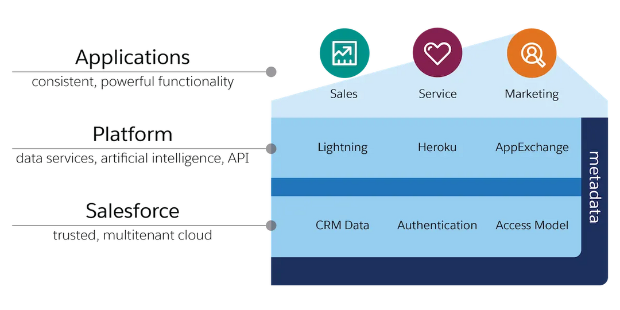

SALESFORCE ARCHITECTURE
Multi-tenant. Speaking about a multi-tenant architecture, there is a single shared application service to several clients. This makes it cost-effective.
01
02
Metadata: Salesforce uses a metadata-driven development model. This allows developers to only focus on building the application. This metadata-driven platform makes customization and scaling up easy.
03
API: Salesforce provides a powerful source of APIs. This helps in developing and customizing the Salesforce1 Mobile App. Every feature of the Salesforce design has been planned and implemented precisely

Slide 6

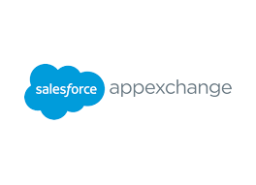
SALESFORCE
APP-EXCHANGE?
Salesforce App-Exchange is a marketplace that offers a wide variety of apps that can be used to extend the functionality of Salesforce. It was created for the Salesforce platform and provides customers with access to a wide range of applications that extend the capabilities of their Salesforce instances.

Slide 7
The Recruitment Management Application is a cloud-based application hosted in Salesforce and designed to streamline the recruitment process for organizations using declarative and custom development. This application will enable organizations to manage Positions, Candidate Profiles, Candidate Skill Set, Job Applications, Candidate Reviews and manage details of Job Postings on various Employment Websites. The goal of this project is to improve the efficiency of the recruitment process, reduce manual workloads, and improve the overall recruitment experience.
Project Overview

Slide 8
The recruitment process can be time-consuming and labor-intensive. HR professionals often spend a lot of time in managing Position Details & Job Postings on different Employment Websites, Tracking Candidate Details, Scheduling Interviews, Aligning Candidates with right skills for a Position for Interviews and maintaining the feedback/reviews. The current process is often fragmented and can result in missed opportunities to attract and retain top talent. There is a need for a centralized tool that can help HR professionals manage the recruitment process more efficiently.
Problem Statement:

Slide 9
EXPECTED OUTCOME
MANAGE JOB POSITIONS BOTH OPEN AND CLOSED
TRACK CANDIDATE DETAILS
ALIGN CANDIDATES WITH THEIR SKILLS SETS.
ALIGNING POSITIONS WITH CANDIDATES WHO APPLIED FOR JOBS.
MAINTAINING THE REVIEW OF CANDIDATES AFTER INTERVIEWS.
CREATING A SUMMARY OF CANDIDATE REVIEWS ON JOB APPLICATION.
MAINTAINING DATA OF VARIOUS EMPLOYMENT WEBSITES SO THAT OPEN POSITIONS CAN BE POSTED THERE.

Slide 10
FEATURES OF SALESFORCE USED
DATA MODEL
(APP, OBJECT, FIELDS, RECORD, TABS )
RELATIONSHIPS (LOOKUP AND MASTER-DETAILS), ROLLUP SUMMARY
PAGE LAYOUTS, COMPACT LAYOUT, RECORD TYPES, FORMULA FIELDS
REPORTS (TABULAR, SUMMARY, MATRIX & JOINED) & DASHBOARDS
SECURITY (PROFILES, PERMISSION SETS, ROLES, OWD, SHARING RULES)
VALIDATION RULES, DUPLICATE RULES & MATCHING RULES
LIGHTNING PAGE (HOME, APP & RECORD PAGES)
FEED TRACKING & FIELD HISTORY TRACKING, LIST VIEWS, ACTIONS
DATA LOADED AND DATA IMPORT WIZARD, APPROVAL PROCESS
FLOWS (SCREENFLOW, RECORD TRIGGERED FLOW, SCHEDULE TRIGGERED)
APEX, TRIGGER, TEST CLASS, LIGHTNING WEB COMPONENT

Slide 11


MODULES COVERED
Create a Custom Object for Reviews
Create a Custom Object for Job Posting Sites
Create a Custom Junction Object for Job Postings
Create a Self Relationship with the Position Object
Create Custom Recruiting Fields

Slide 12
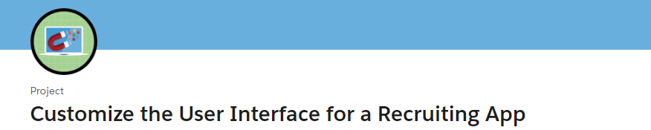
MODULES COVERED
Create a Tab for the Review Object
Create an Object-Specific Quick Action
Customize the Review Page Layout
Create a Custom Candidate Record Page
Create Record Types on the Position Object
Customize the Position Page Layout
Enable Chatter on the Review Object

Slide 13
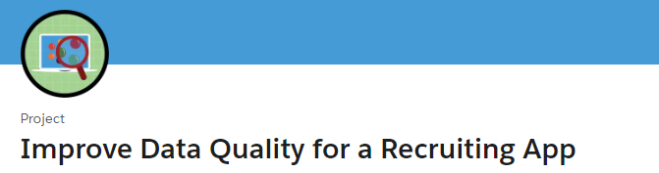
MODULES COVERED
Create Cross-Object Formulas
Create Validation Rules
Create Formula and Roll-Up Summary Fields

Slide 14
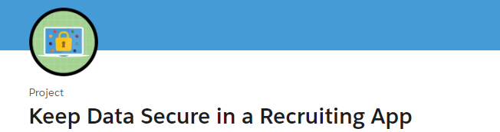
MODULES COVERED
Create Custom Profiles
Restrict Access with Field-Level Security, Permission Sets, and Sharing Settings

Slide 15
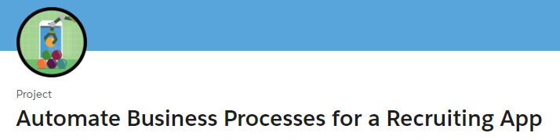
MODULES COVERED
Build an Automation for Creating Interviewer Records
Lay the Groundwork for an Approval Process
Create an Approval Process
Create Automation for Submitting Positions for Approval
Create a Candidate Rating Flow

Slide 16

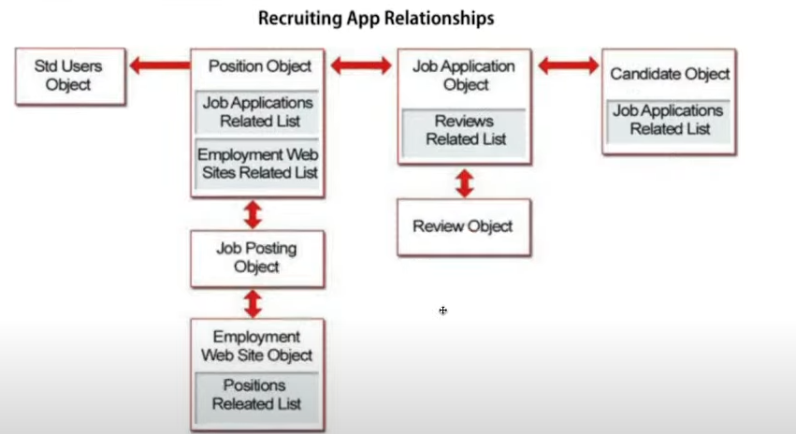

Slide 17
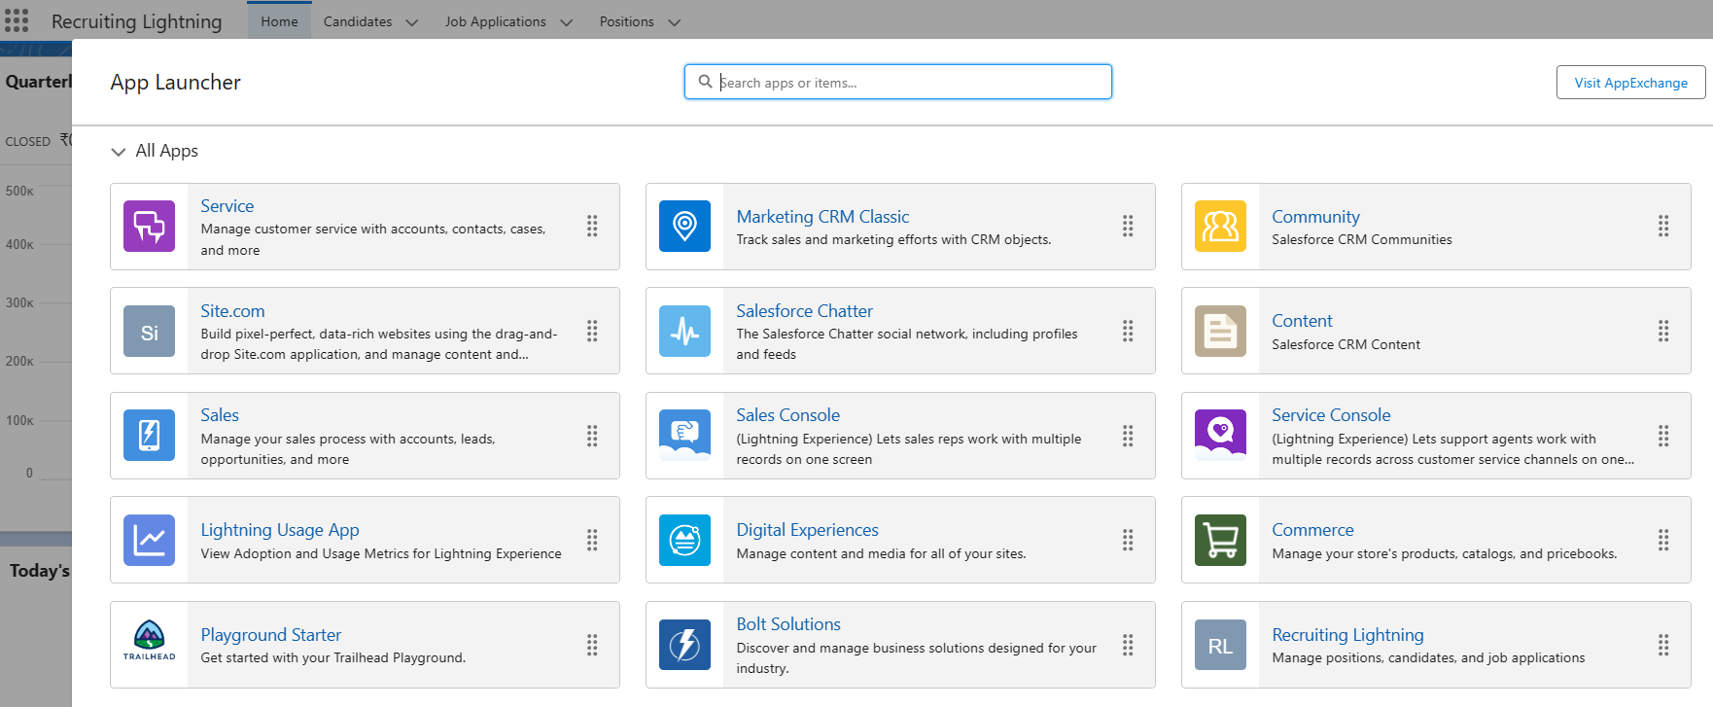

Slide 18
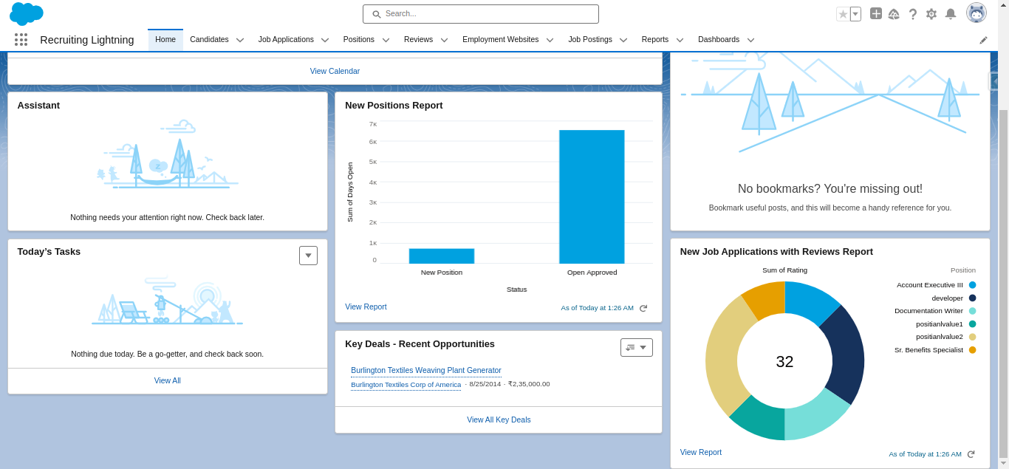

Slide 19
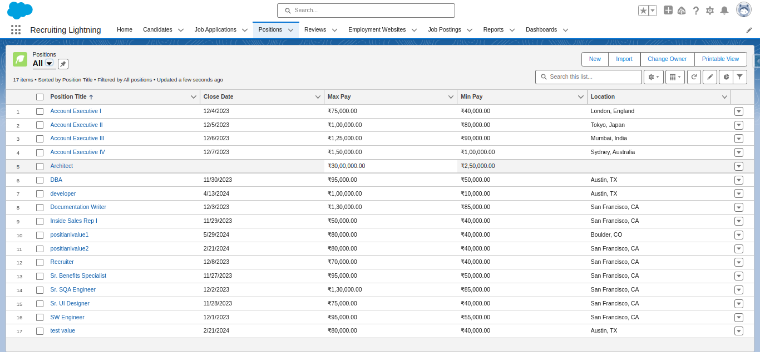

Slide 20
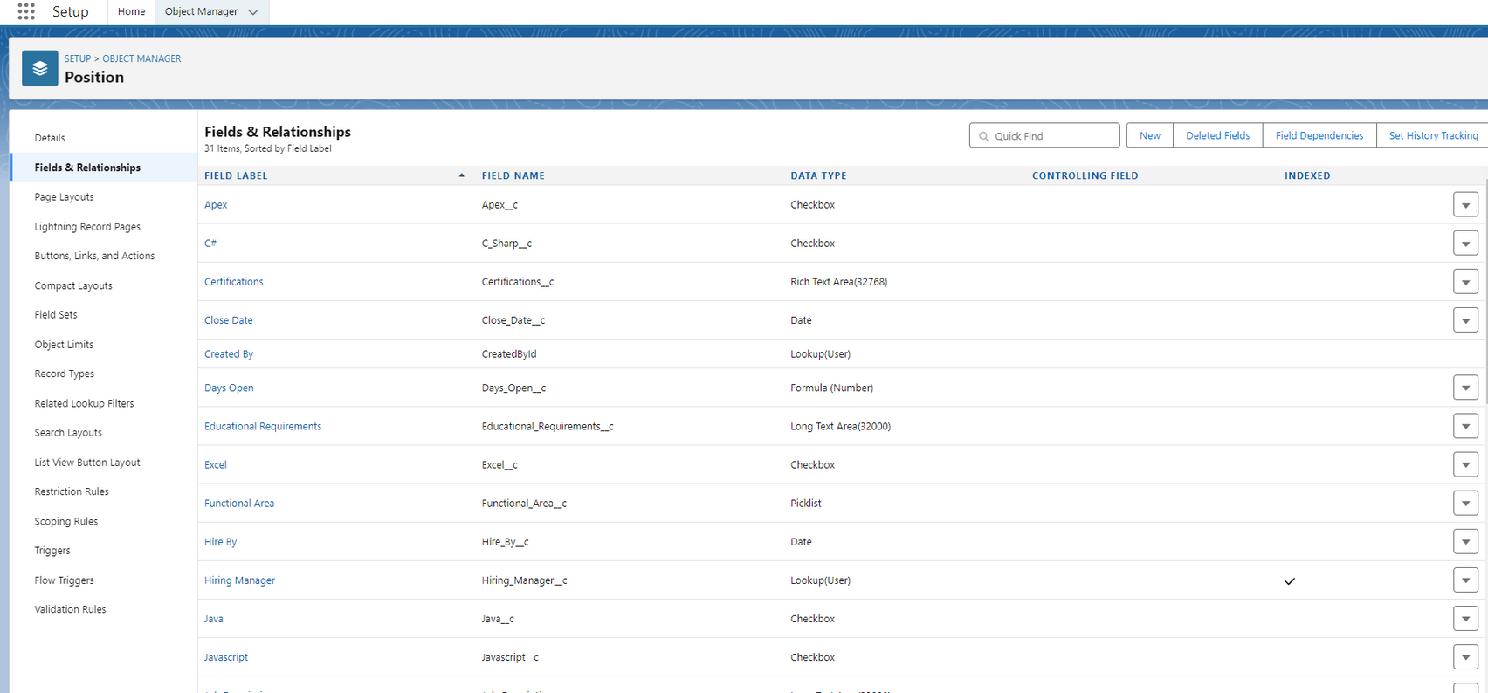

Slide 21
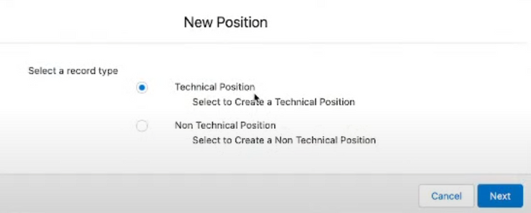
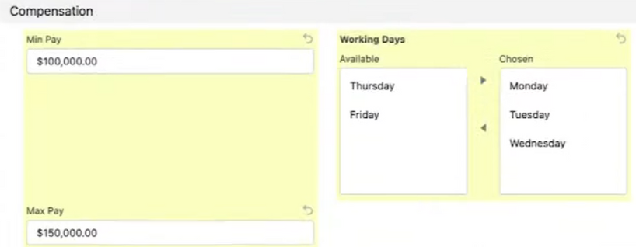
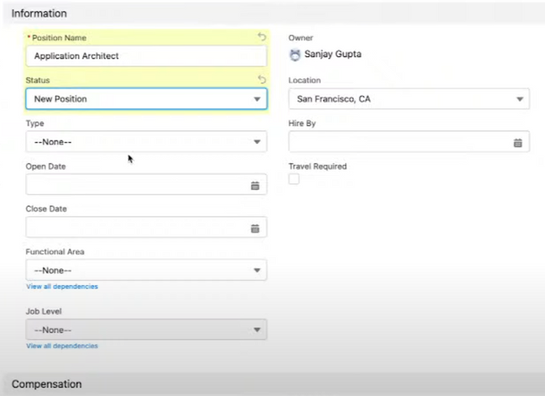
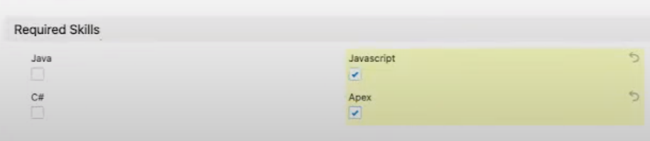
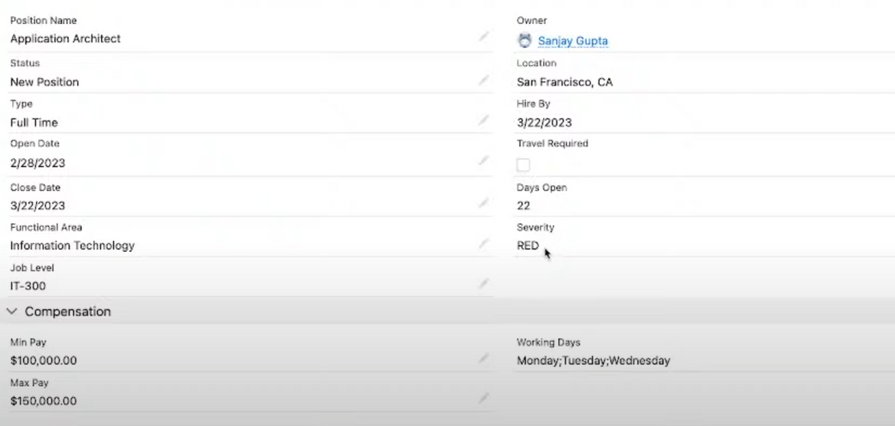
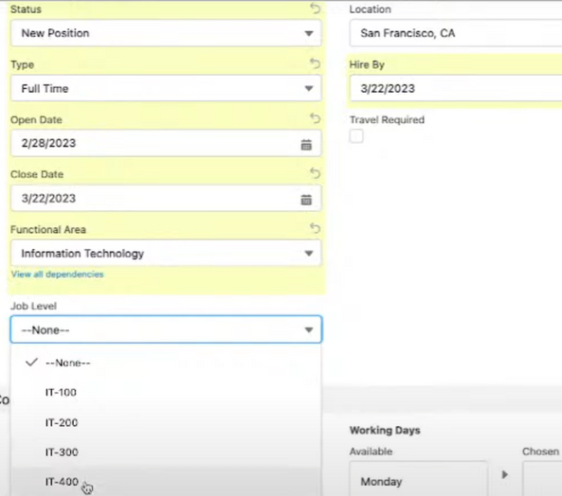

Slide 22
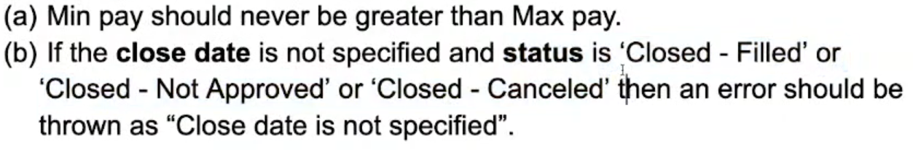
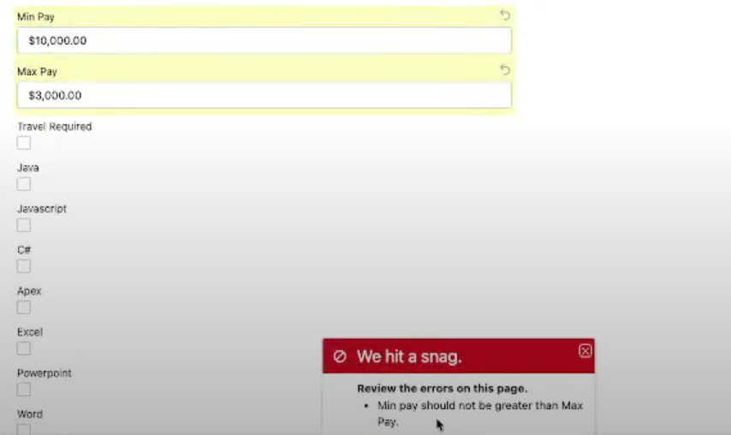
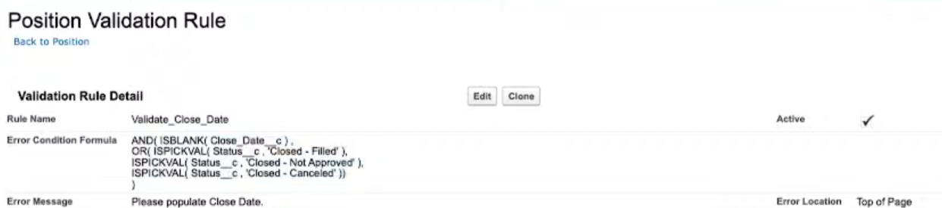
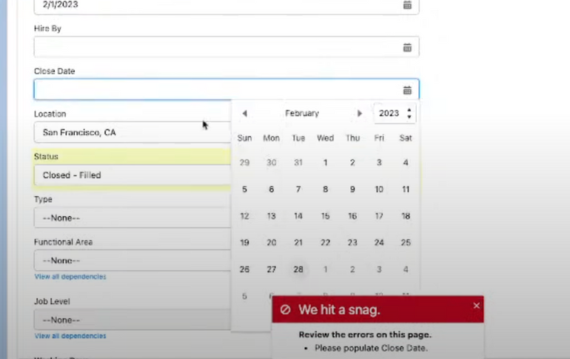

Slide 23
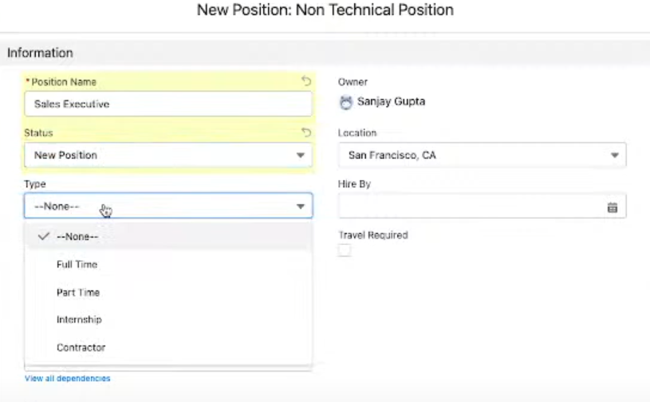
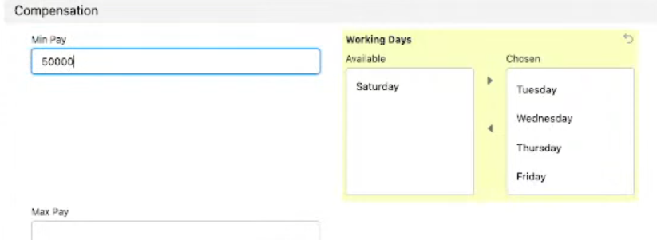
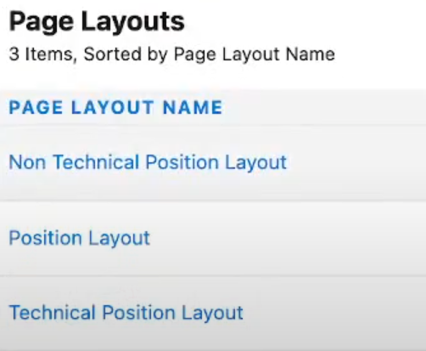
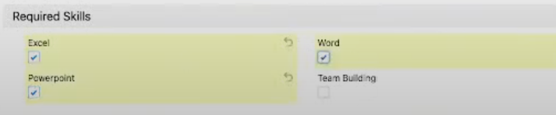

Slide 24
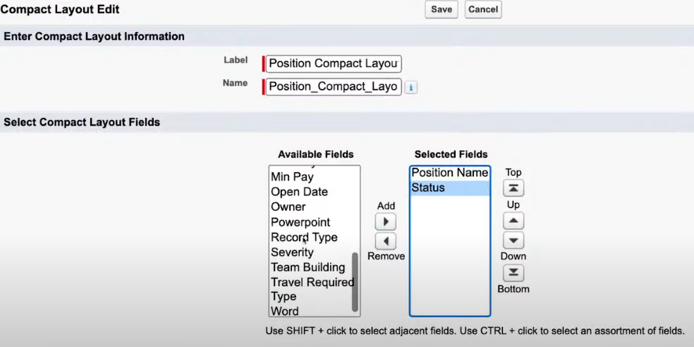
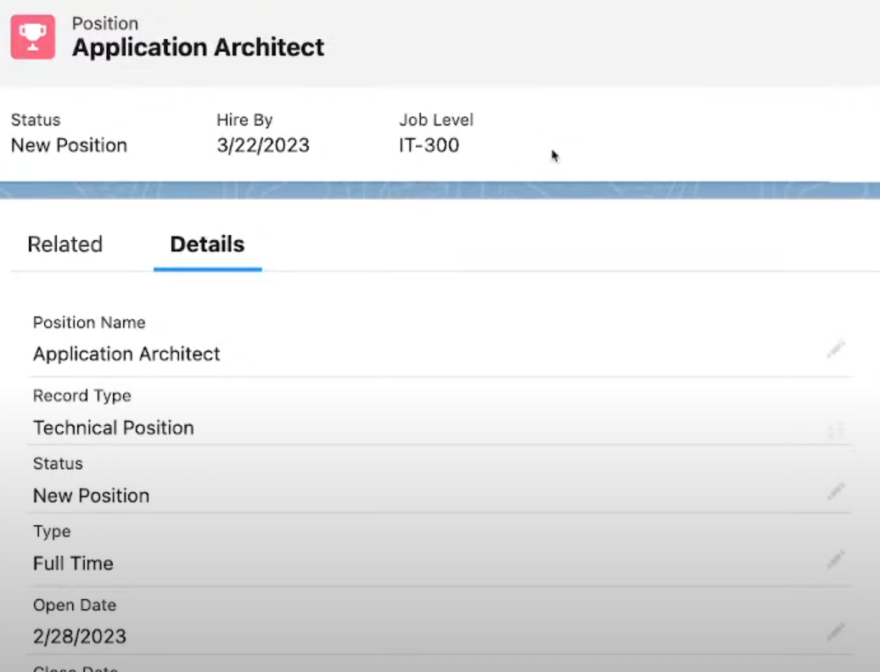

Slide 25
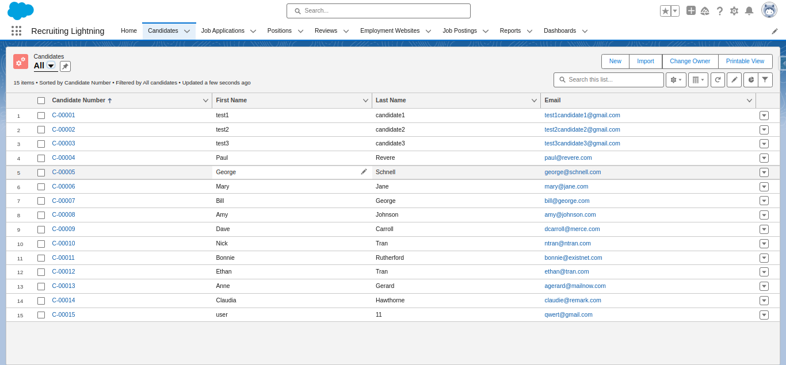

Slide 26
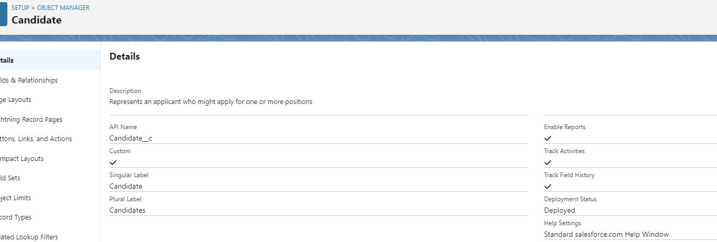
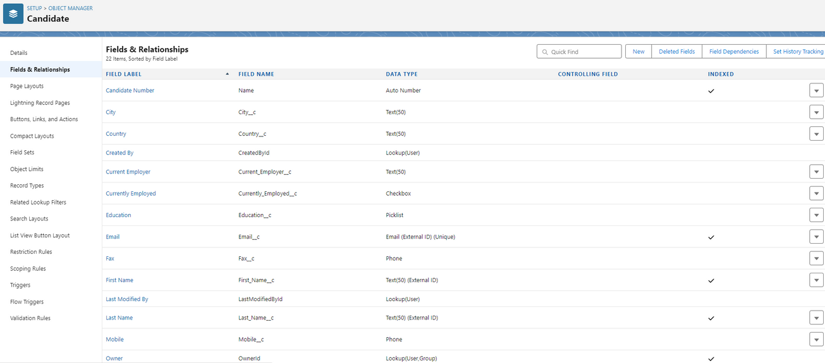
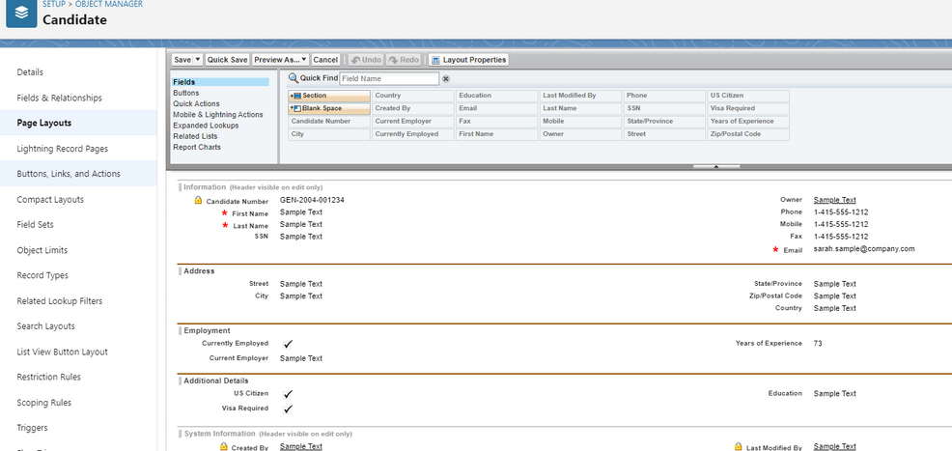

Slide 27
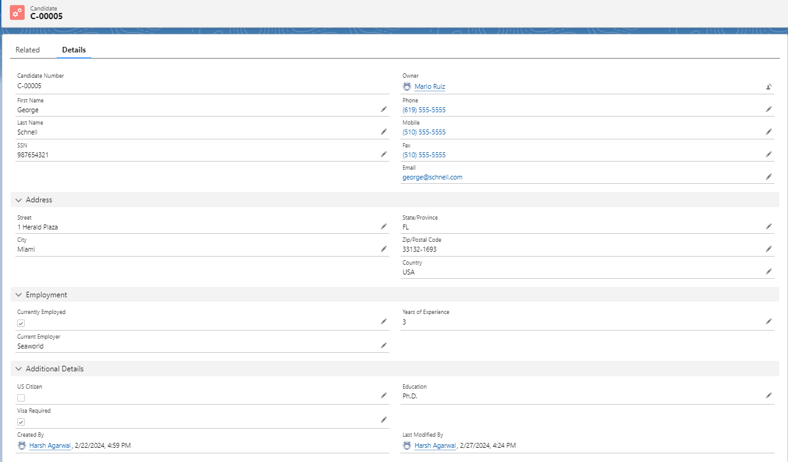
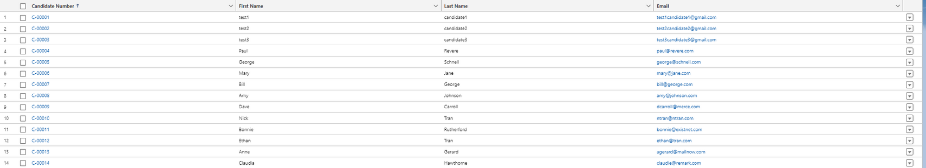

Slide 28
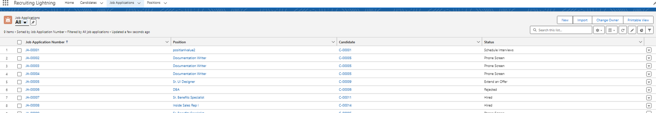
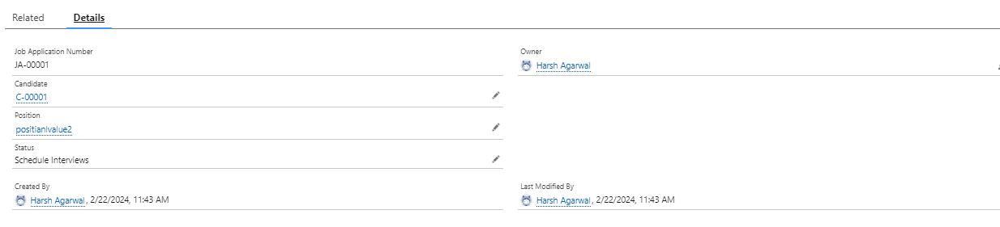
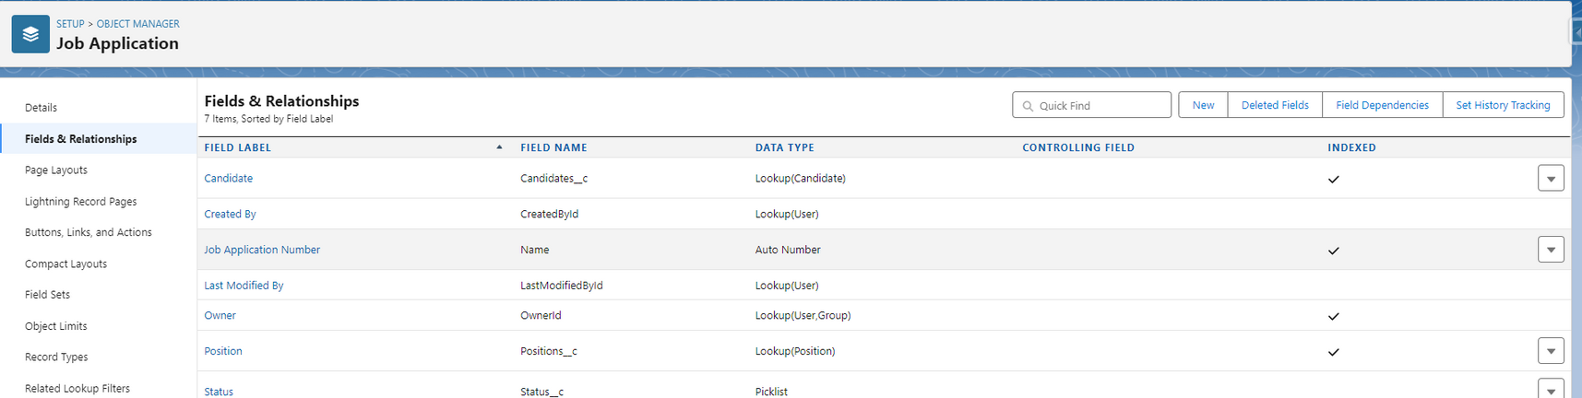

Slide 29
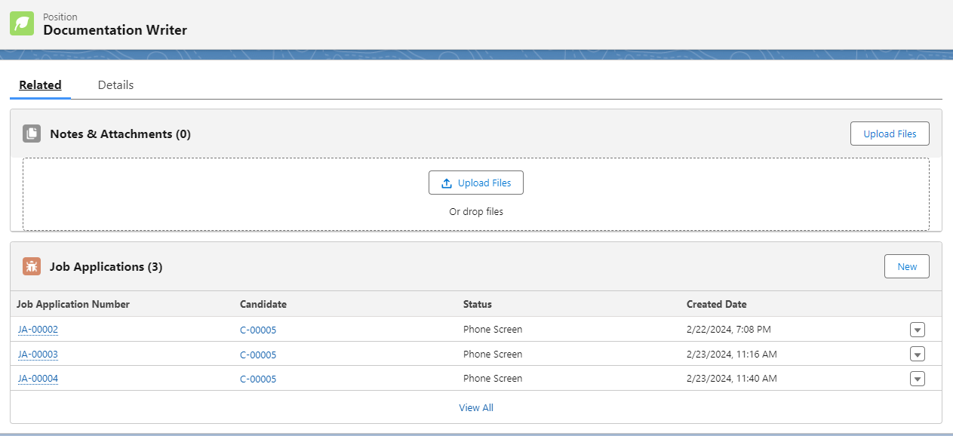
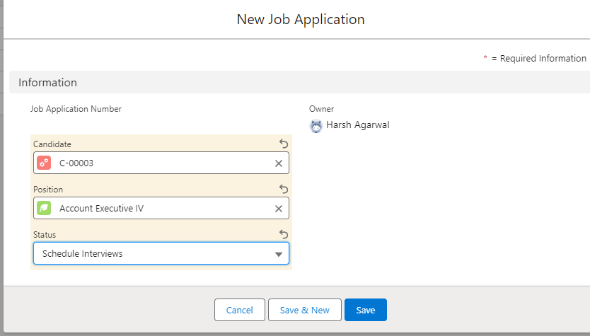
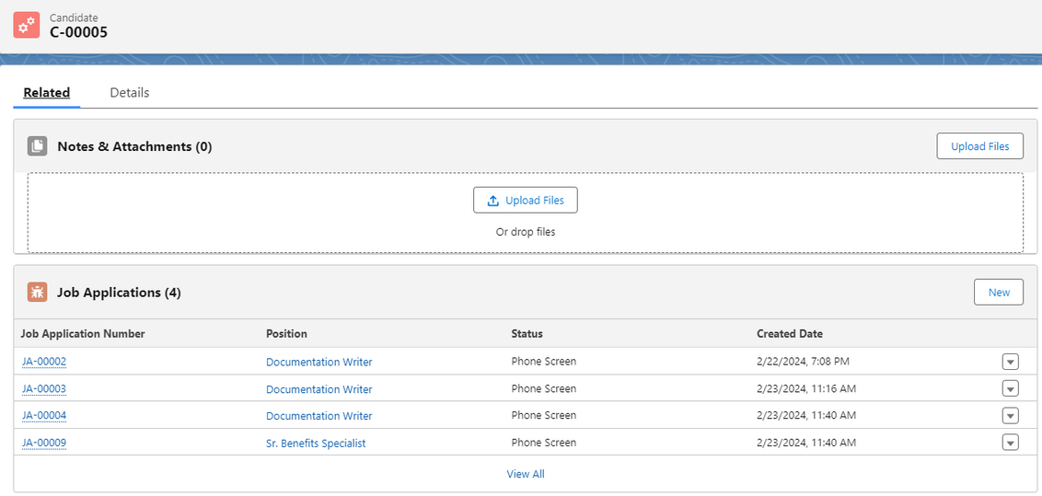

Slide 30
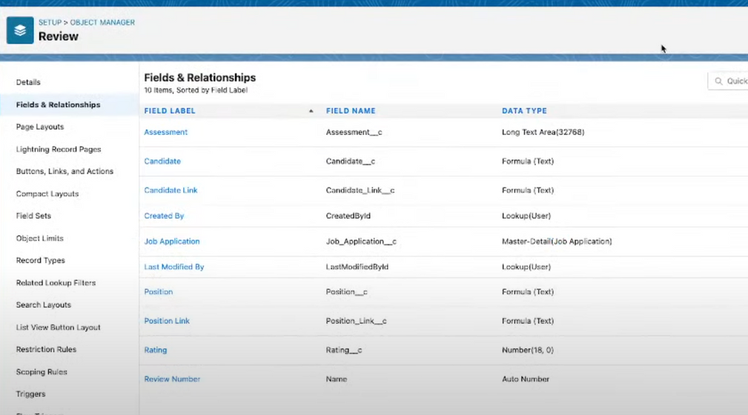
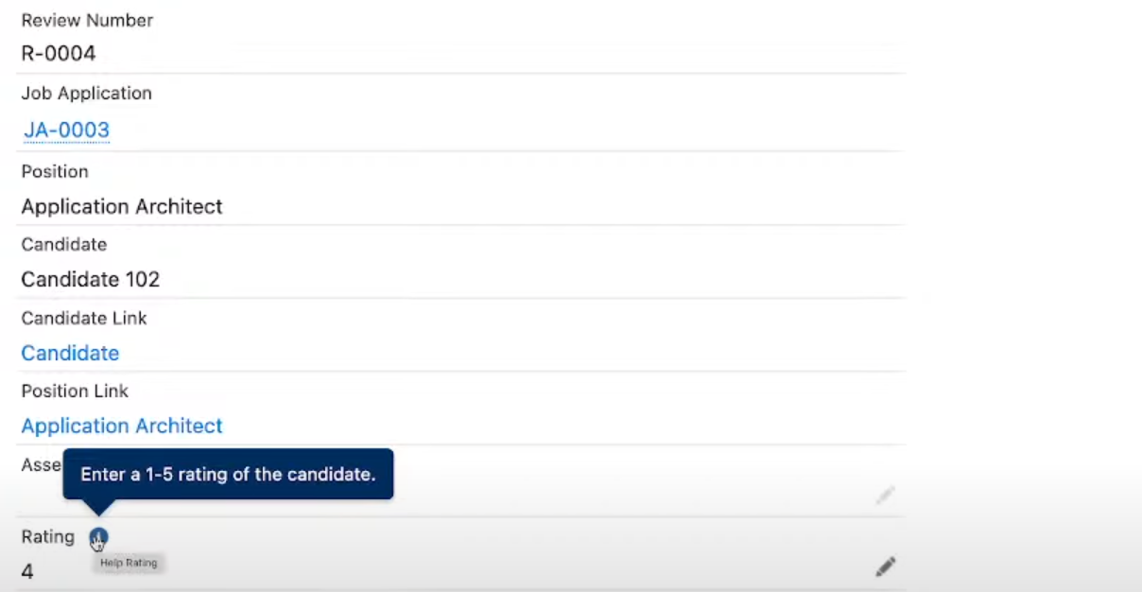
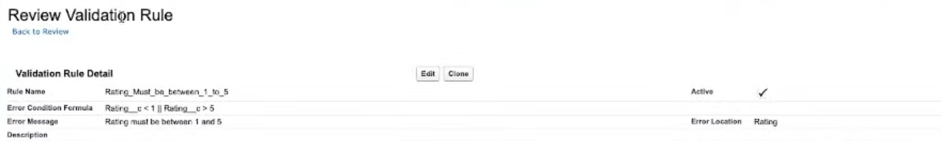
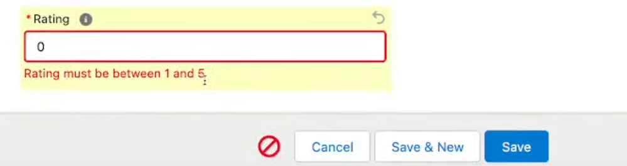

Slide 31
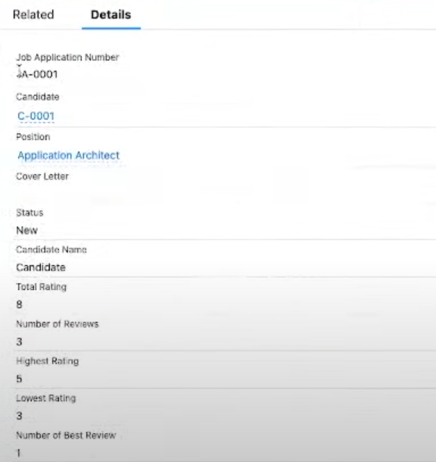
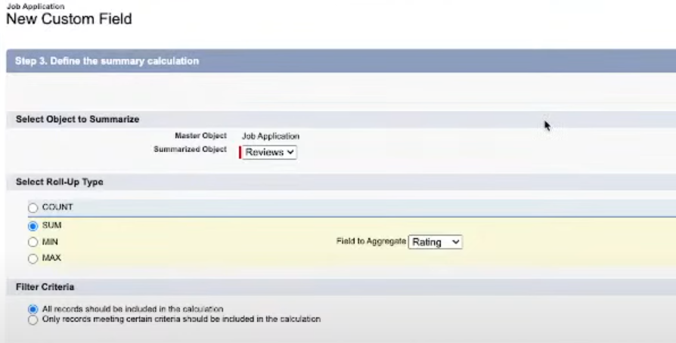

Slide 32
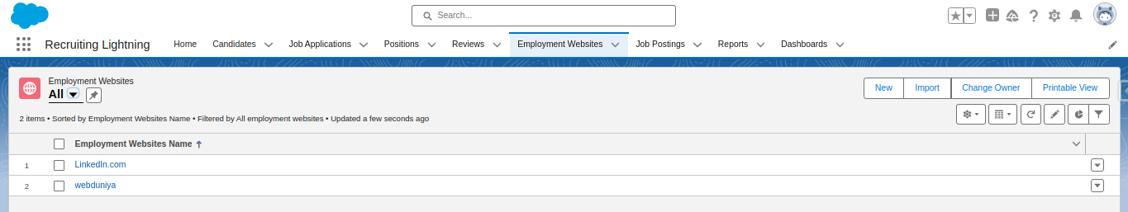
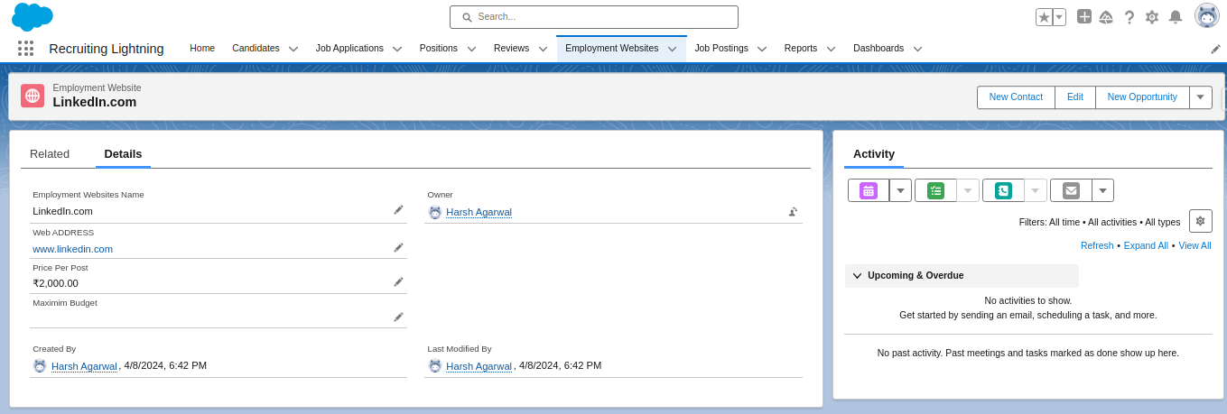

Slide 33
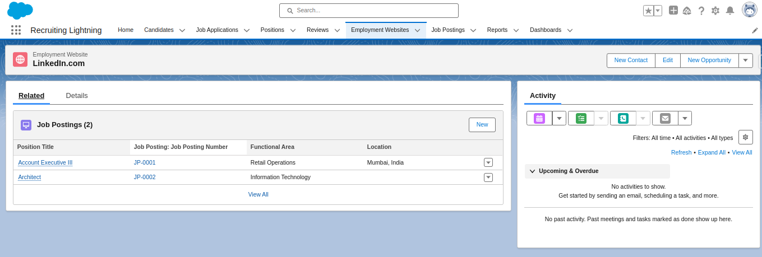
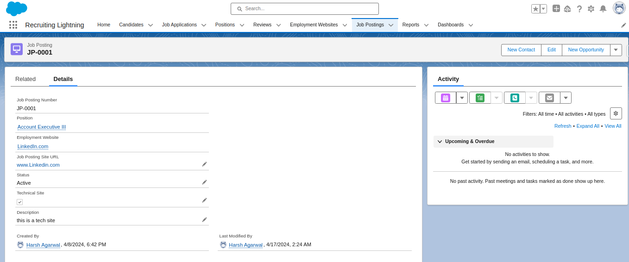
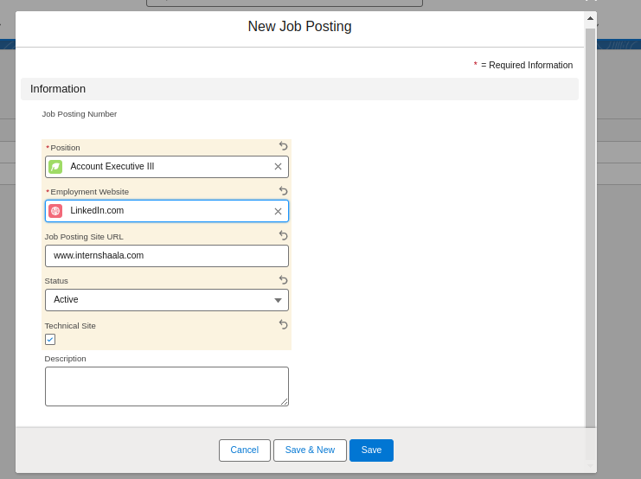

Slide 34



Slide 35


Slide 36
CONCLUSIONS
THE RECRUITMENT MANAGEMENT APPLICATION STREAMLINES THE RECRUITMENT PROCESS FOR ORGANIZATIONS.
IT OFFERS ROBUST TOOLS FOR MANAGING POSITIONS, CANDIDATES, JOB APPLICATIONS, AND REVIEWS.
FEATURES SUCH AS VALIDATION RULES AND FORMULA FIELDS ENSURE DATA INTEGRITY AND ACCURACY.
FIELD TRACKING PROVIDES INSIGHTS INTO CANDIDATE PROFILES AND APPLICATION STATUSES OVER TIME.
PERMISSION SETS, USER SETTINGS, OWD, AND SHARING RULES CONTRIBUTE TO SECURE DATA MANAGEMENT AND COLLABORATION.
OVERALL, THE APPLICATION OPTIMIZES RECRUITMENT WORKFLOWS, IMPROVES DECISION-MAKING, AND ENHANCES THE CANDIDATE EXPERIENCE.

Slide 37
Thank You !

